Slide 1
Tableau
.

Slide 2
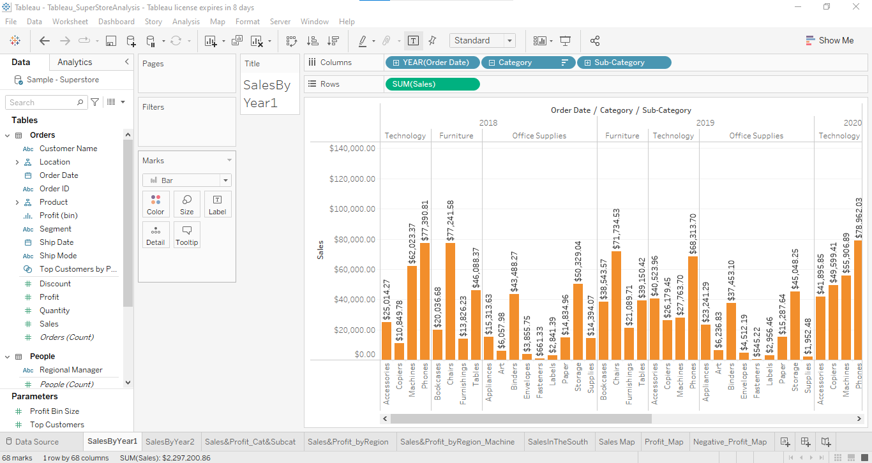
1. Find the sales for every year

Slide 3
2. Find year for highest sales and lowest sales respectively.
By looking graph we can came to know that in 2021 we have highest sale than compare to 2018,2019,2020 and in the category of technology the phones are highest sale of $105,340.52
And the lowest sale was in the year 2018 and 2019 in both year we have somewhat equal sale compare to the next years.

Slide 4
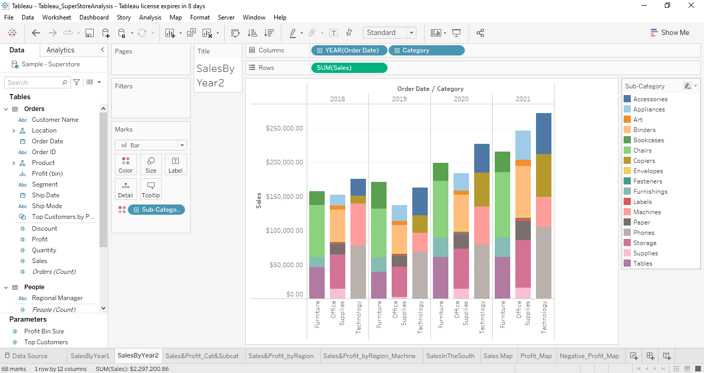

Slide 5
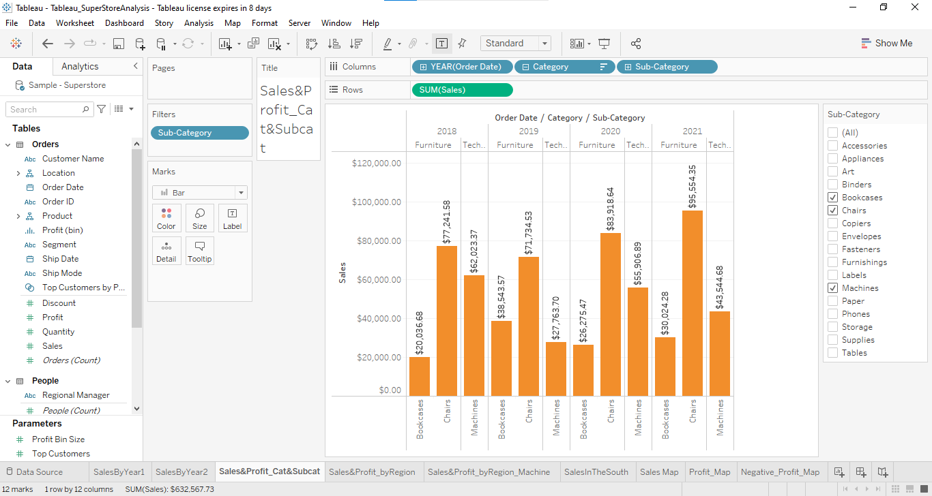
3. Find the category wise sales for every year.

Slide 6
Which category has highest sales in the year 2020 & 2021.
By graph in both the year 2020&2021 the furniture category has highest sale.
Based on the analysis of the year 2020 & 2021. give some suggestions to improve Sales in the year 2022.
To increase the sales we have to take more actions on advertising, marketing and reaching the customer satisfaction, delivering products safely and on time.

Slide 7
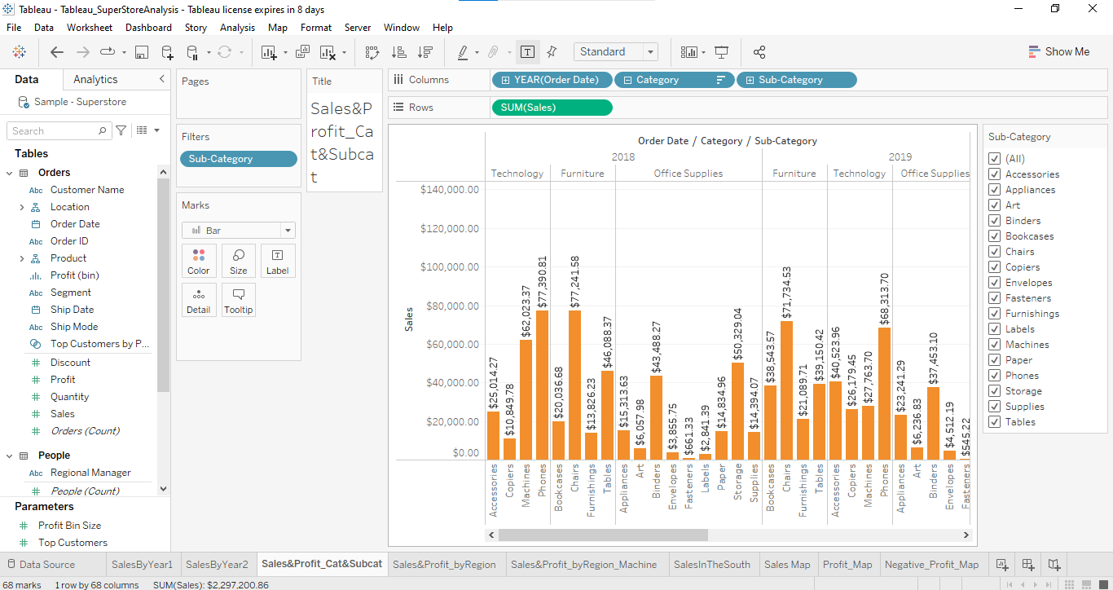
Display subcategory and find some insights from the view about max and min sales under every category.

Slide 8
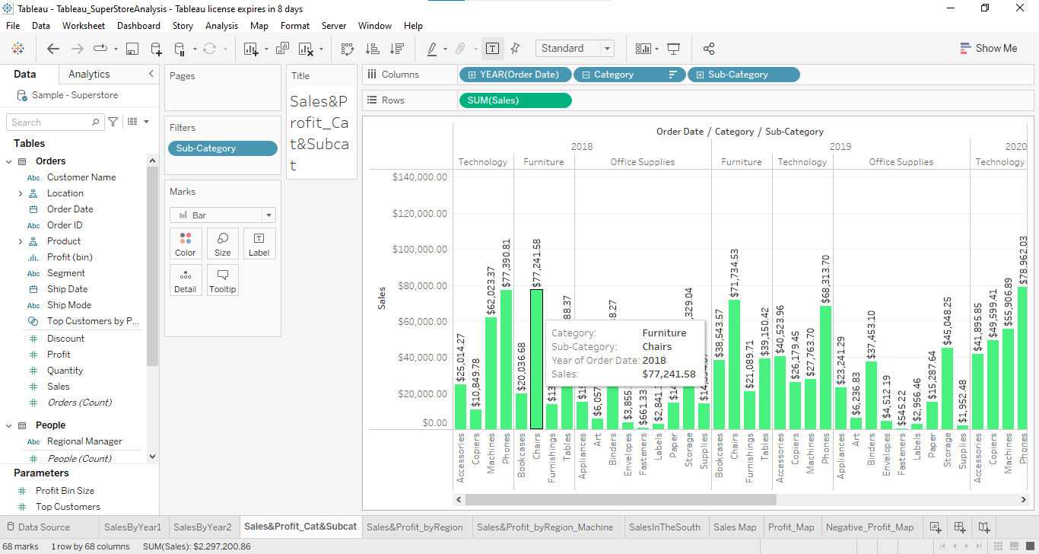
Change the color of your visual Check the Tooltip.

